Slide 1

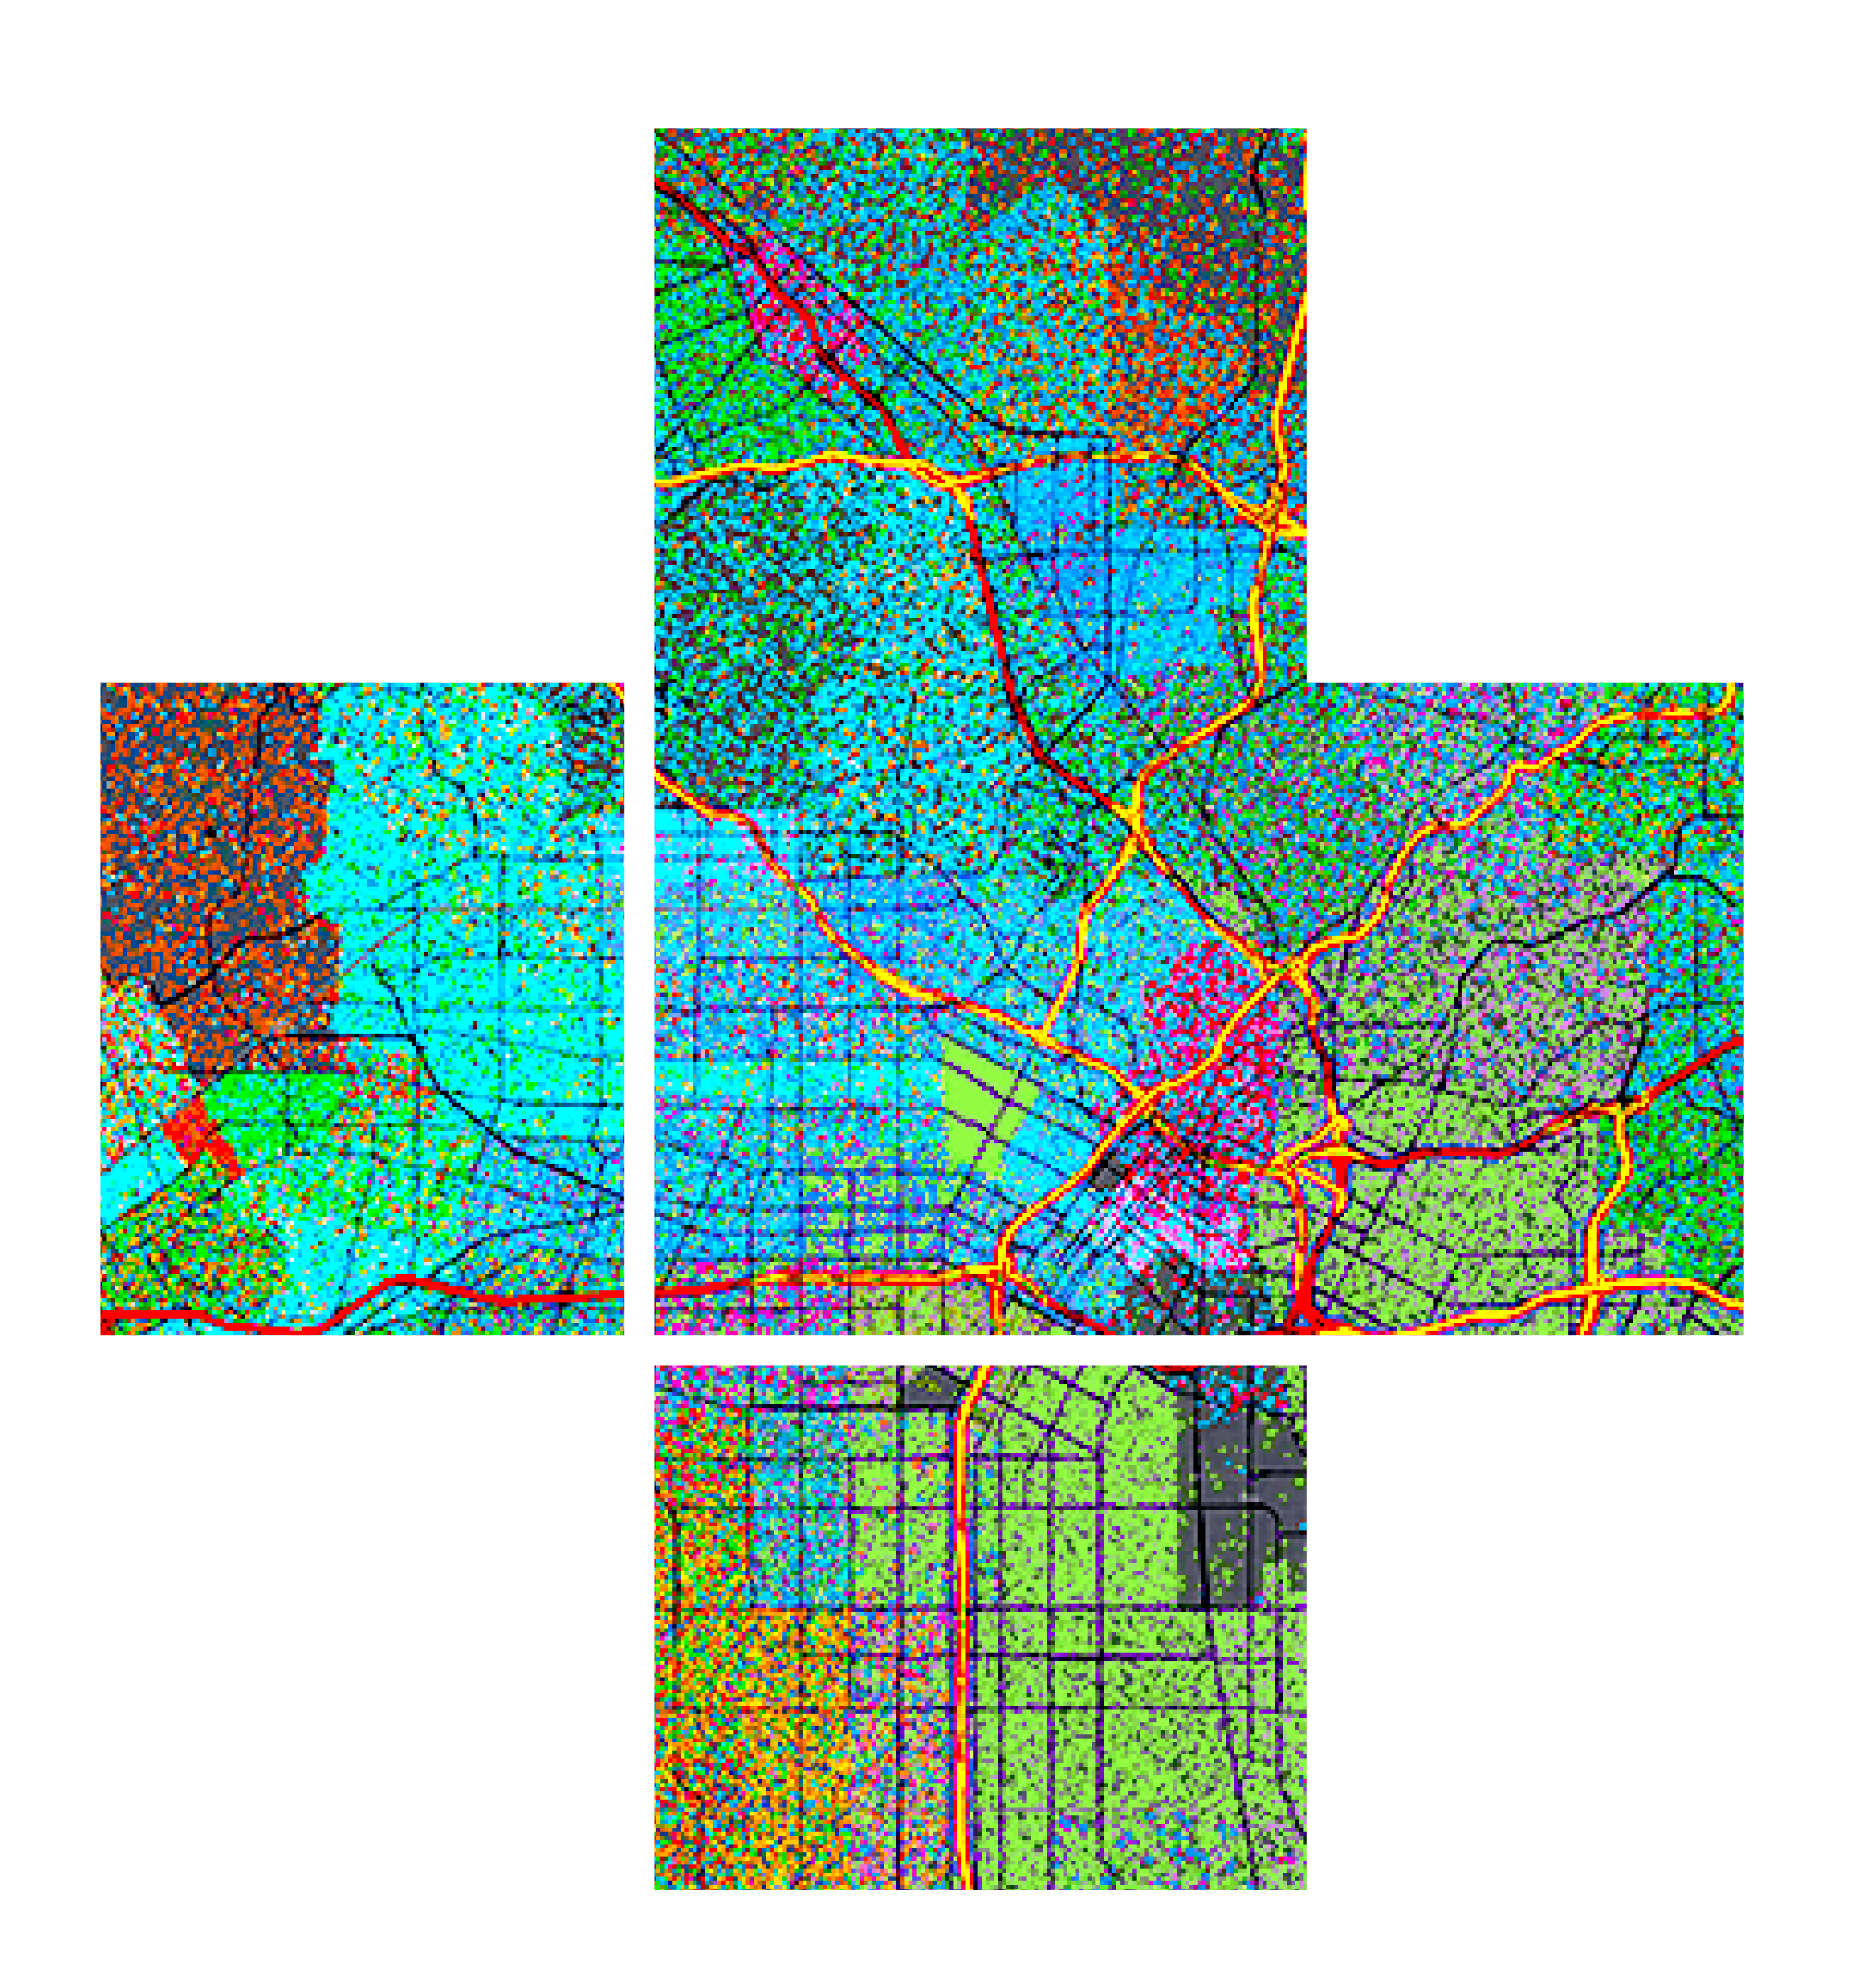








Developer Primer: Svelte Support and Services Spotlight Theater
Please leave artwork “+” clustered.
Do not use them alone, as bullet points, or as a “plus” concept. Thank you.
Gavin Rehkemper @gavinrehkemper
Jacob Wasilkowski @jwasilgeo
2020 ESRI DEVELOPER SUMMIT | Palm Springs, CA

Slide 2







Svelte: “Cybernetically enhanced web apps”

Slide 3
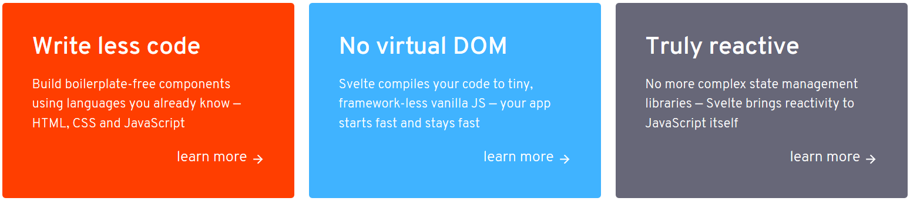
Bold claims
“Svelte is a radical new approach to building user interfaces. Whereas traditional frameworks like React and Vue do the bulk of their work in the browser, Svelte shifts that work into a compile step that happens when you build your app.”

Slide 4


Components

Slide 5
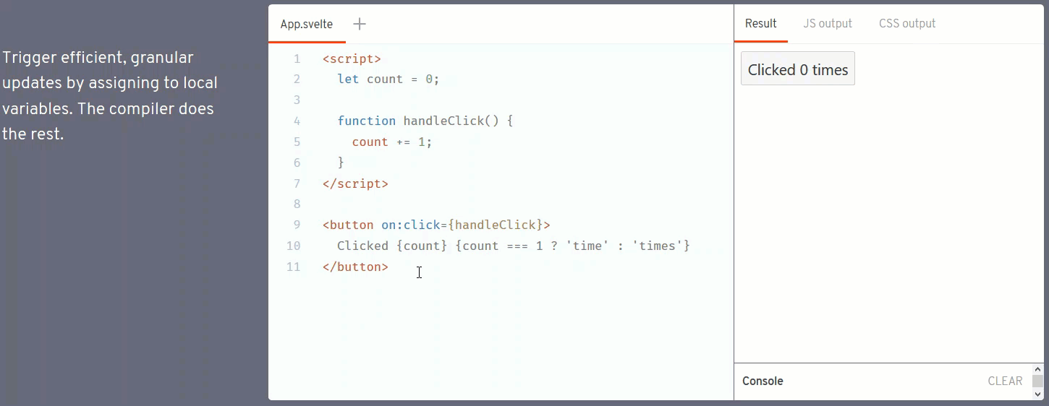
Component structure: JS, HTML, & CSS with a few helpers

Slide 6
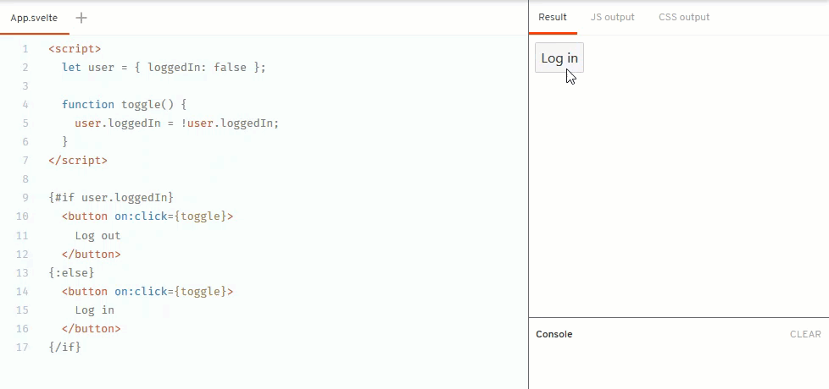
Component HTML logic helpers: if / else blocks

Slide 7

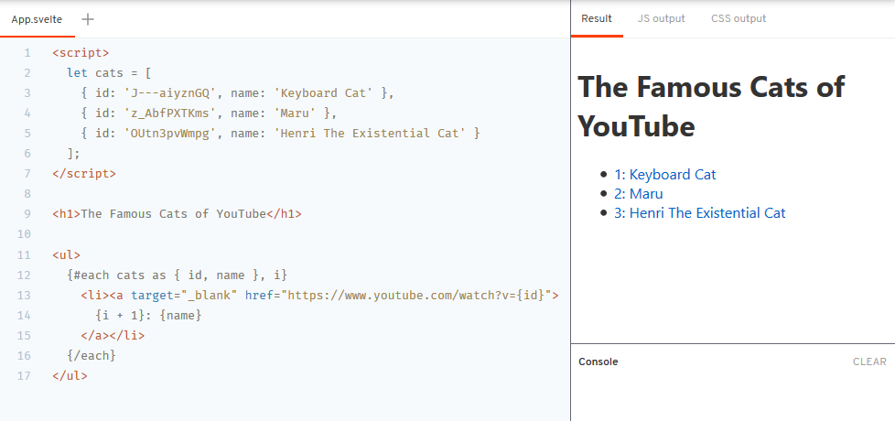


Component HTML logic helpers: each blocks

Slide 8
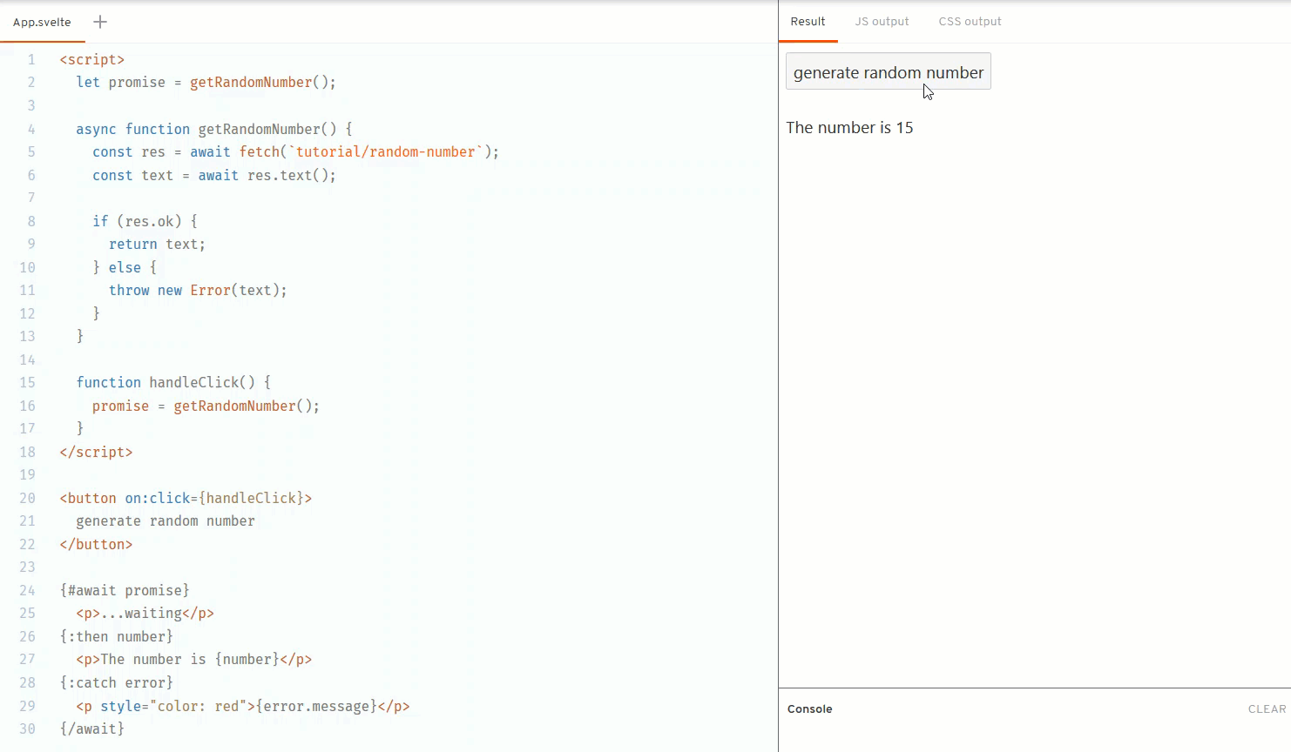
Component HTML logic helpers: await promise blocks

Slide 9
Props
Notes:
GAVIN

Slide 10

Props
Notes:
GAVIN

Slide 11
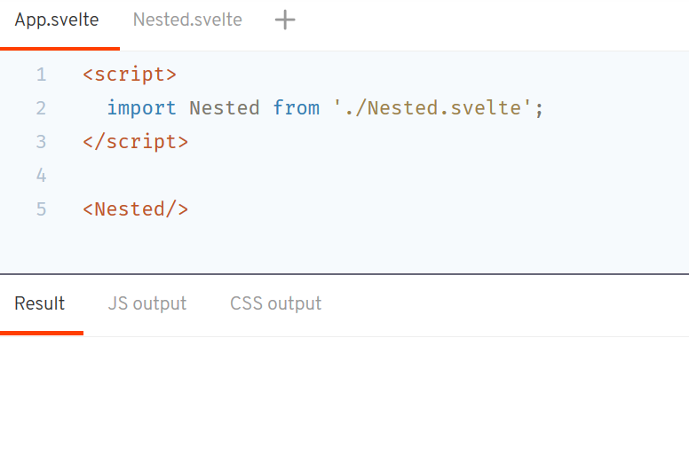
Props

Slide 12
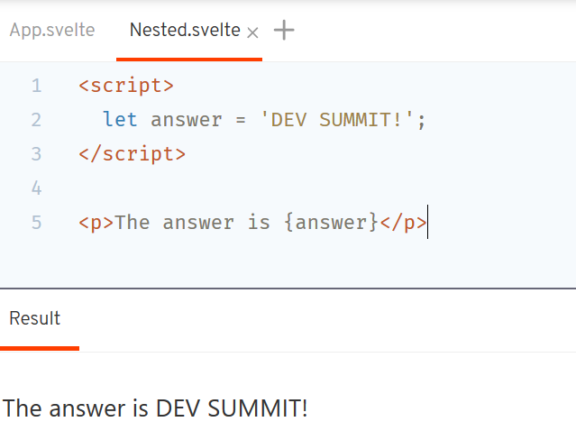
Props

Slide 13
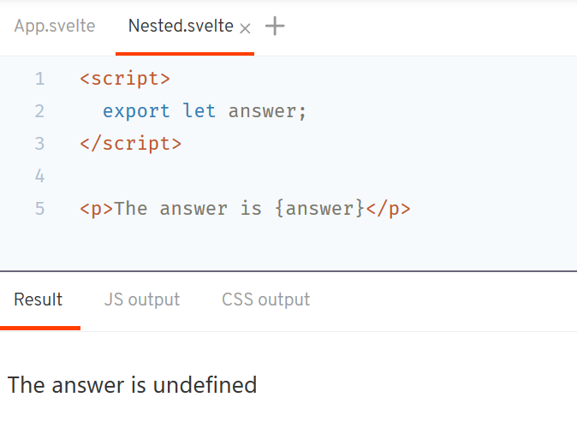
Props

Slide 14
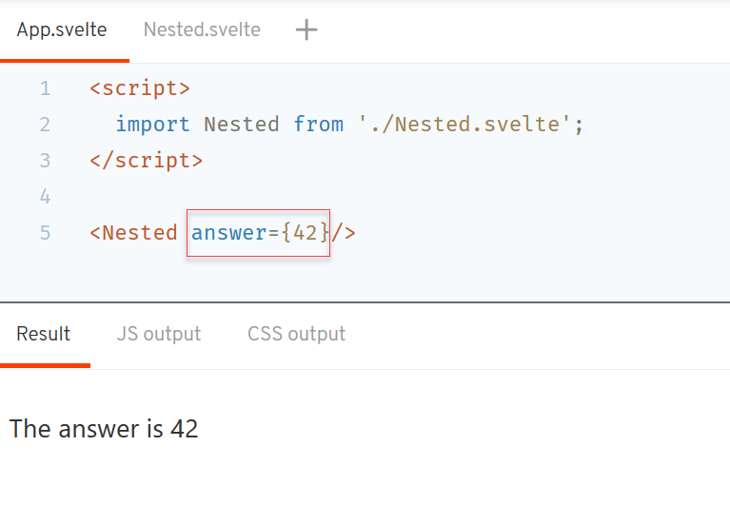
Props

Slide 15
Events
Remember REACTIVITY (from before) …

Slide 16
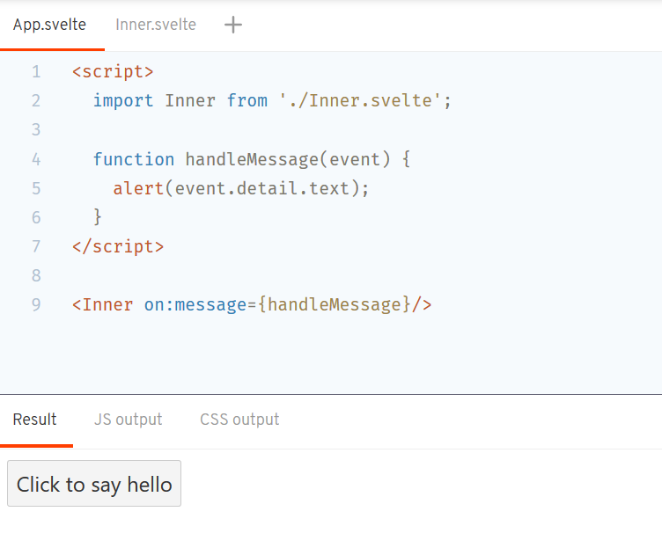
SAME Syntax for your own components!

Slide 17
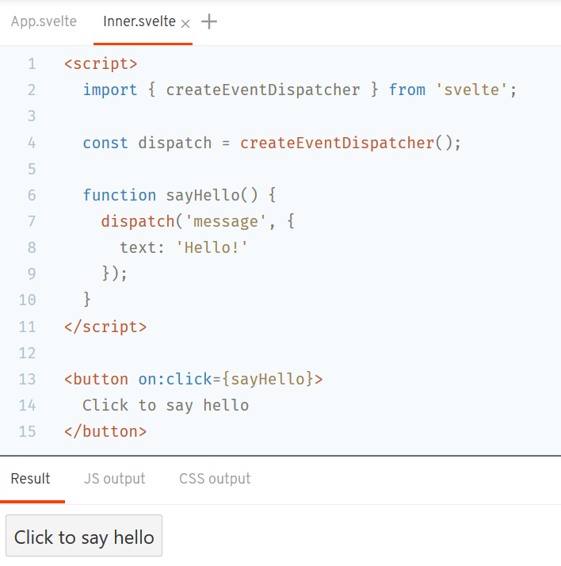
But how to I emit the event?

Slide 18
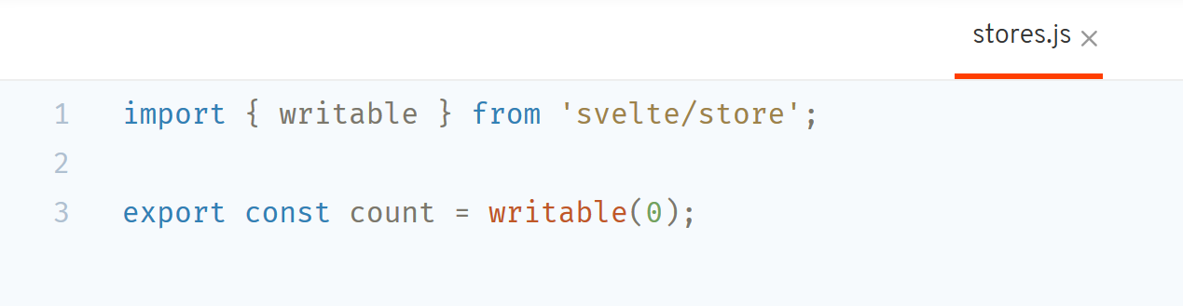
Stores
Notes:
A store is simply an object with a subscribe method that allows interested parties to be notified whenever the store value changes.

Slide 19
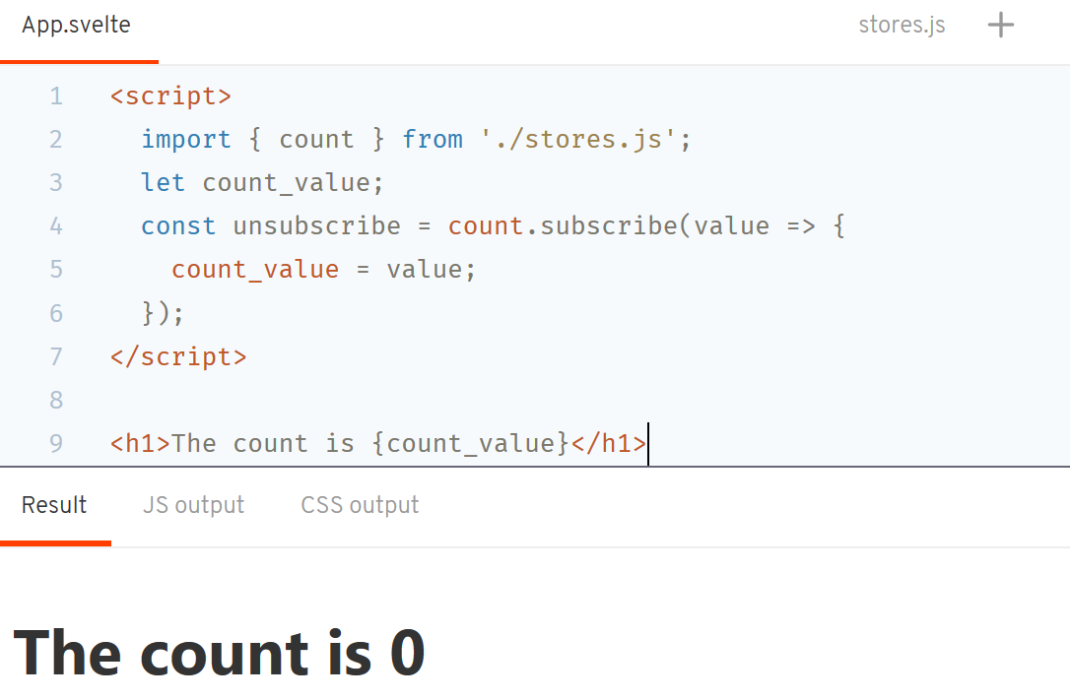
Notes:
A store is simply an object with a subscribe method that allows interested parties to be notified whenever the store value changes.

Slide 20
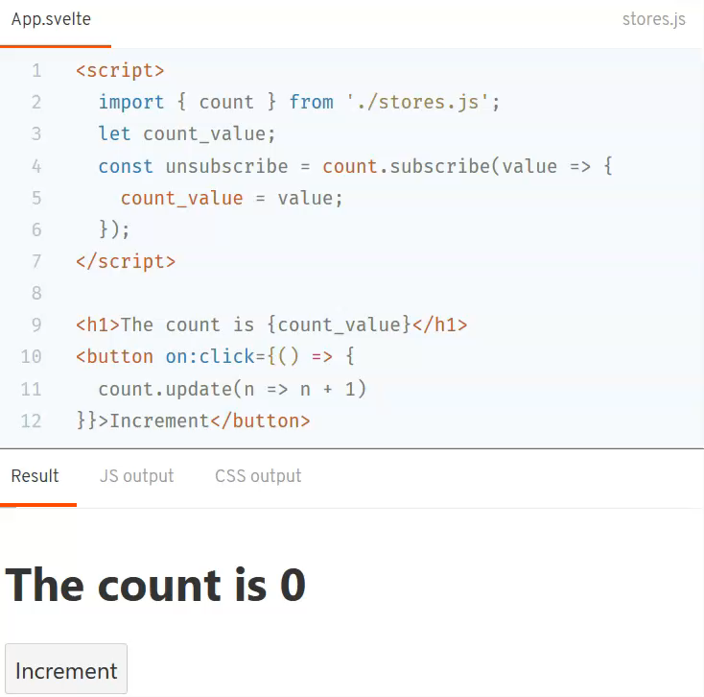
Notes:
A store is simply an object with a subscribe method that allows interested parties to be notified whenever the store value changes.

Slide 21
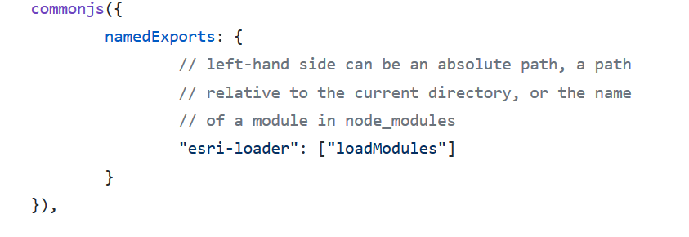
Load the ArcGIS API for JavaScript with esri-loader
“npm install esri-loader”
Rollup.config.js:
https://esri-svelte-example.surge.sh/

Slide 22
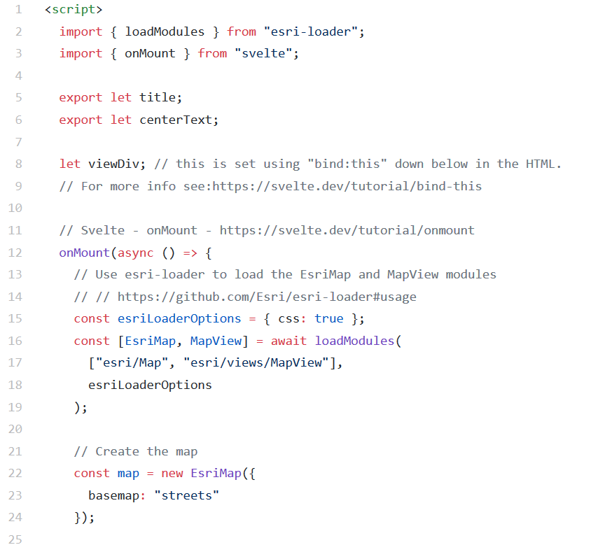
Load the ArcGIS API for JavaScript with esri-loader
Same as other esri-loader apps!
https://esri-svelte-example.surge.sh/

Slide 23
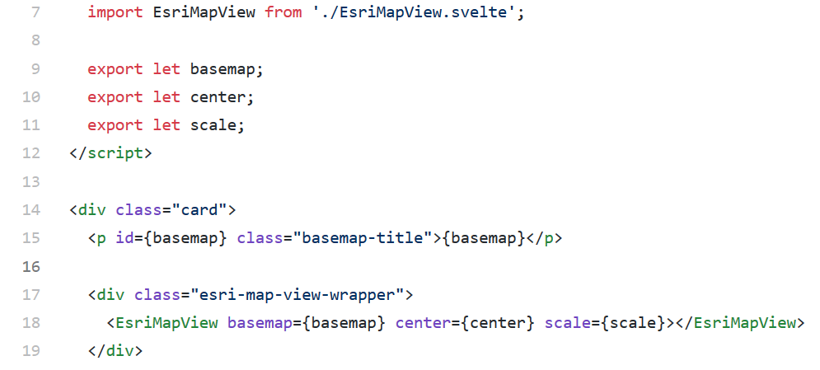
Load the ArcGIS API for JavaScript with esri-loader
Wrap your map as a Svelte component!
https://esri-svelte-basemaps-example.now.sh/

Slide 24
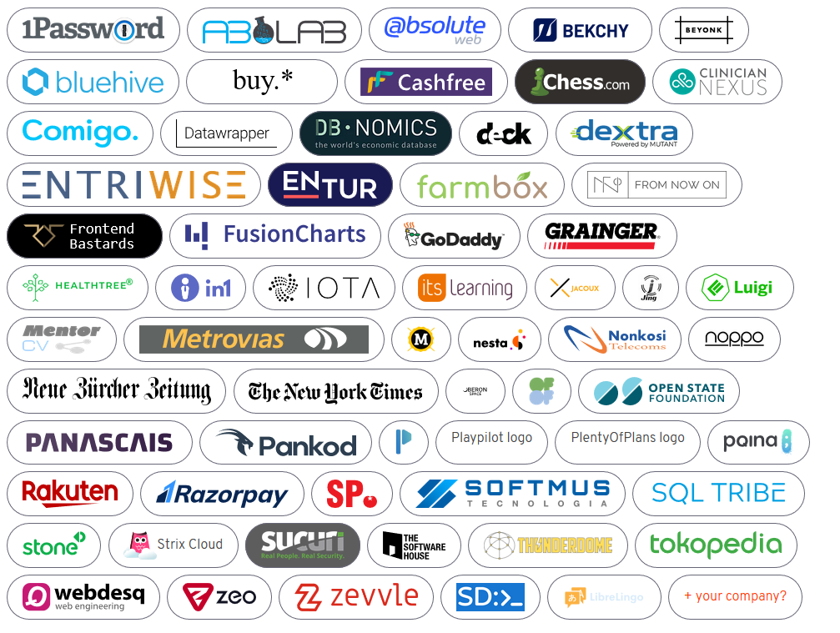
Real-World Apps?
data4pakistan.com
[others in progress]
Yours here! Let us know!

Slide 25
Resources
https://svelte.dev/
Interactive tutorial https://svelte.dev/tutorial/
Chat https://svelte.dev/chat
Articles
Svelte – Svelte 3: Rethinking reactivity
Svelte – Write less code
DEV – Svelte Crash Course (in 10 pics!)
CSS Tricks – Getting Acquainted With Svelte, the New Framework on the Block
Felt Co-op – Why Svelte is our choice for a large web project in 2020

Slide 26


Bonus: Sapper!
https://sapper.svelte.dev/

